Slide 1
Intermediate OpenMP for Perl Programmers
Brett Estrade
<OODLER@cpan.org>

Slide 2
GCC – GOMP
GNU Offloading and Multi Processing Runtime Library https://gcc.gnu.org/wiki/openmp
GCC 4.2 supports OpenMP spec 2.5
GCC 4.4 supports OpenMP spec 3.0
GCC 4.7 supports OpenMP spec 3.1
OpenMP spec 4.1 support:
  C/C++ support in GCC 4.9
  Fortran support in GCC 4.9.1
GCC 5 supports offloading (e.g., to GPU)
GCC 6 supports OpenMP spec 4.5 for C/C++
GCC 7 mostly supports OpenMP spec 4.5 for Fortran (fully in GCC 11)
GCC 9 partially supports OpenMP spec 5.0 for C/C++
GCC 10 adds OpenMP spec 5.0 support and initial Fortran support

Slide 3
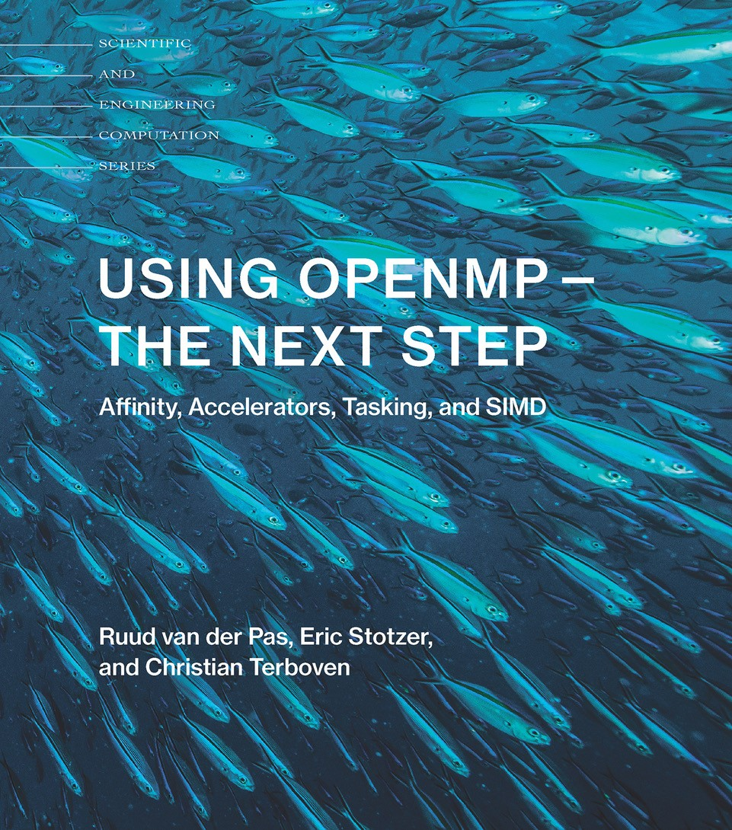
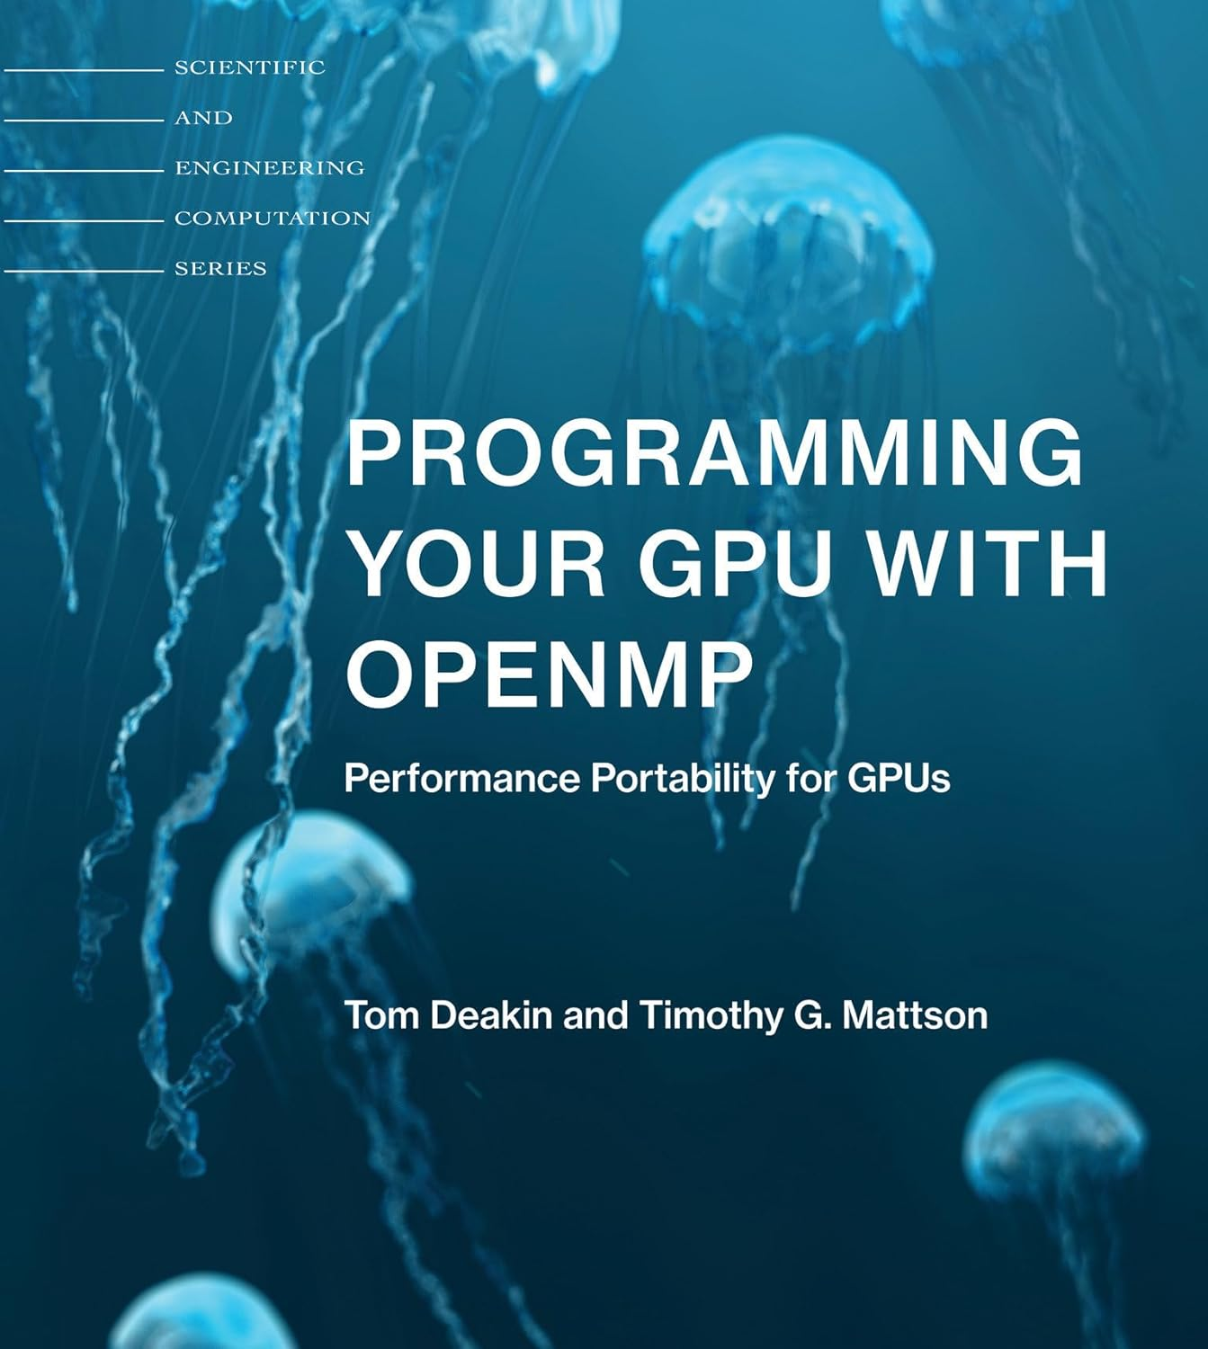
Recommended Books

Slide 4
Talk Assumptions
Discussing only C examples (so C++ or Fortran)
Information based on OpenMP spec 4.5
Any GCC >= 5
Note: regarding wider compiler support:
OpenMP is supported by many commercial compilers
Inline::C uses the compiler used to create perl
We assume 99+% perl's are compiled with GCC

Slide 5
Current State of Perl Options
OpenMP is best accessed from Perl via Inline::C. We assume GCC (see previous slide). Examples in this talk will use the following Perl modules:
Alien::OpenMP
  Works “with” Inline::C
OpenMP::Simple
  Alien::OpenMP + helper C functions & macros
OpenMP::Environment
  Perlish way to interact with %ENV OpenMP cares about
No compiler support beyond GCC is planned (is there a demand?)
.

Slide 6
Example Perl Program
use strict;
use warnings;
use OpenMP::Simple;
use OpenMP::Environment;
use Test::More tests => 8;
use Inline (
C => 'DATA',
with => qw/OpenMP::Simple/,
);
my $env = OpenMP::Environment->new;
note qq{Testing macro provided by OpenMP::Simple, 'PerlOMP_UPDATE_WITH_ENV__NUM_THREADS'};
for my $num_threads ( 1 .. 8 ) {
my $current_value = $env->omp_num_threads($num_threads);
is _get_num_threads(), $num_threads,
sprintf qq{The number of threads (%0d) spawned in the OpenMP runtime via OMP_NUM_THREADS, as expected},
$num_threads;
}
__DATA__
__C__
int _get_num_threads() {
PerlOMP_UPDATE_WITH_ENV__NUM_THREADS
int ret = 0;
#pragma omp parallel
{
#pragma omp single
ret = omp_get_num_threads();
}
return ret;
}
__END__

Slide 7
General Use Case Addressed
An HPC developer familiar with OpenMP and Perl wants to use Perl as “host” language as the driver for OpenMP based Inline::C calls
The perl process is not threaded, subroutines are
Perl variables are fairly regular (e.g., 1D or 2D arrays, list of strings, etc)
Nearly all data accesses to Perl variable is read-only

Slide 8
Example, OpenMP + C + GCC
#include <stdio.h>
#include <omp.h>
int main() {
int ret = 0;
#pragma omp parallel
{
#pragma omp single
{
ret = omp_get_num_threads();
}
}
printf("running with %d threads\n", ret);
return ret;
}
Output:
running with 48 threads
./first-example.x
running with 48 threads

Slide 9
Example, OpenMP + Perl
1..8
ok 1 - The number of threads (1) spawned in the OpenMP
# runtime via OMP_NUM_THREADS, as expected
ok 2 - The number of threads (2) spawned in the OpenMP
# runtime via OMP_NUM_THREADS, as expected
ok 3 - The number of threads (3) spawned in the OpenMP
# runtime via OMP_NUM_THREADS, as expected
ok 4 - The number of threads (4) spawned in the OpenMP
# runtime via OMP_NUM_THREADS, as expected
ok 5 - The number of threads (5) spawned in the OpenMP
# runtime via OMP_NUM_THREADS, as expected
ok 6 - The number of threads (6) spawned in the OpenMP
# runtime via OMP_NUM_THREADS, as expected
ok 7 - The number of threads (7) spawned in the OpenMP
# runtime via OMP_NUM_THREADS, as expected
ok 8 - The number of threads (8) spawned in the OpenMP
# runtime via OMP_NUM_THREADS, as expected
use strict;
use warnings;
use OpenMP::Simple;
use OpenMP::Environment;
Use Test::More tests => 8;
use Inline (
C => 'DATA',
with => qw/OpenMP::Simple/,
);
my $env = OpenMP::Environment->new;
for my $num_threads ( 1 .. 8 ) {
my $current_value = $env->omp_num_threads($num_threads);
is _get_num_threads(),$num_threads,
sprintf qq{The number of threads (%0d) spawned in the OpenMP
runtime via OMP_NUM_THREADS, as expected}, $num_threads;
}
__DATA__
__C__
int _get_num_threads() {
PerlOMP_UPDATE_WITH_ENV__NUM_THREADS
int ret = 0;
#pragma omp parallel
{
#pragma omp single // first thread to reach here runs it, no others
ret = omp_get_num_threads();
}
return ret;
}

Slide 10
Recap
Following slides recap the last few talks on OpenMP
Please find and watch my other TPRC talks on OpenMP for Perl programmers
And here we go...

Slide 11
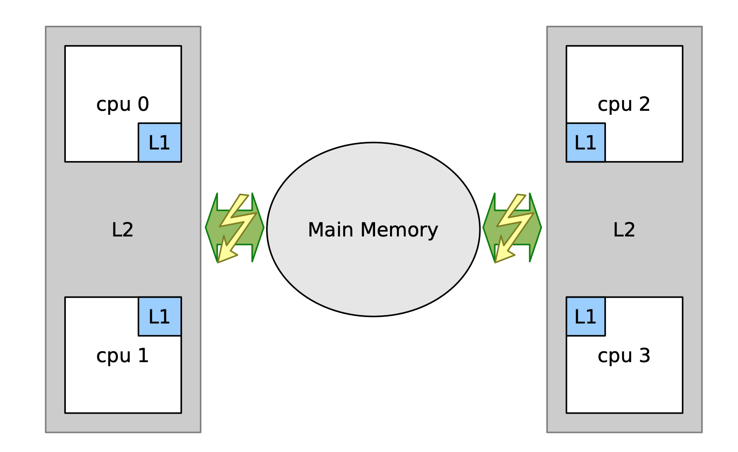
OpenMP Memory Models
Recap!

Slide 12
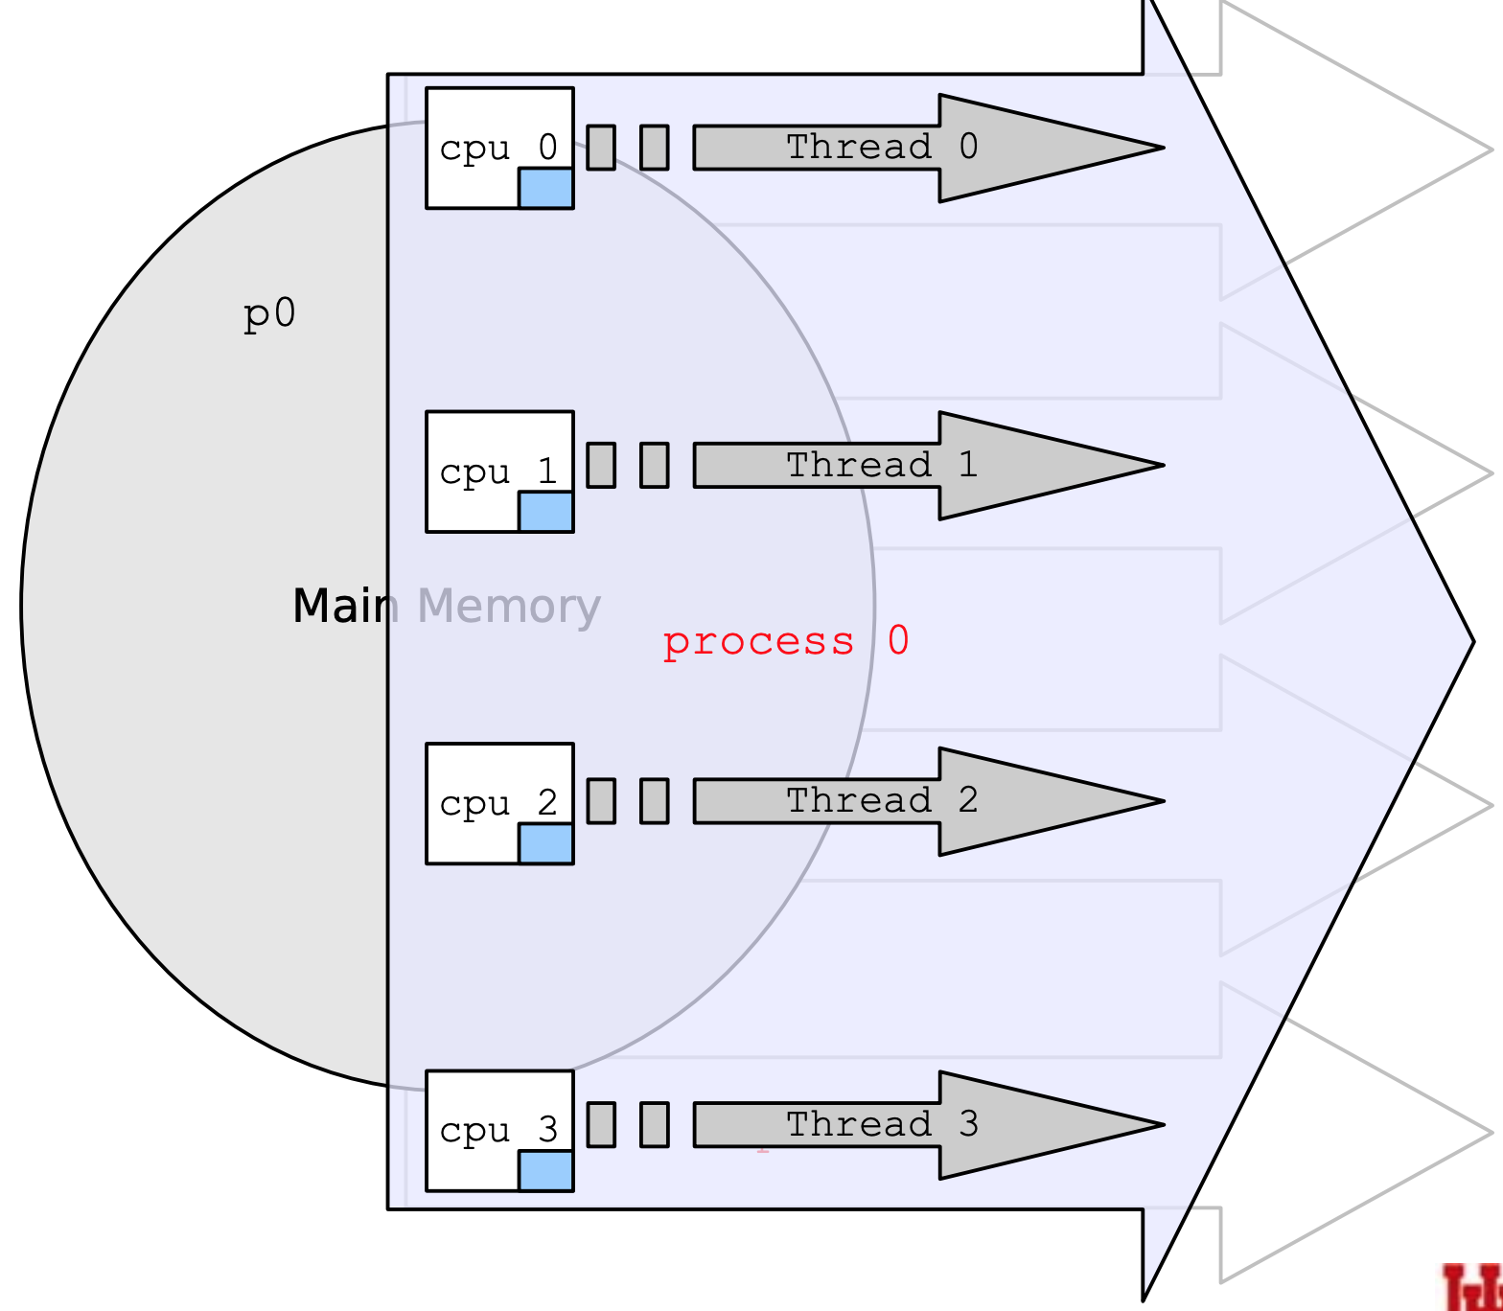
OpenMP Memory Models
Recap!

Slide 13
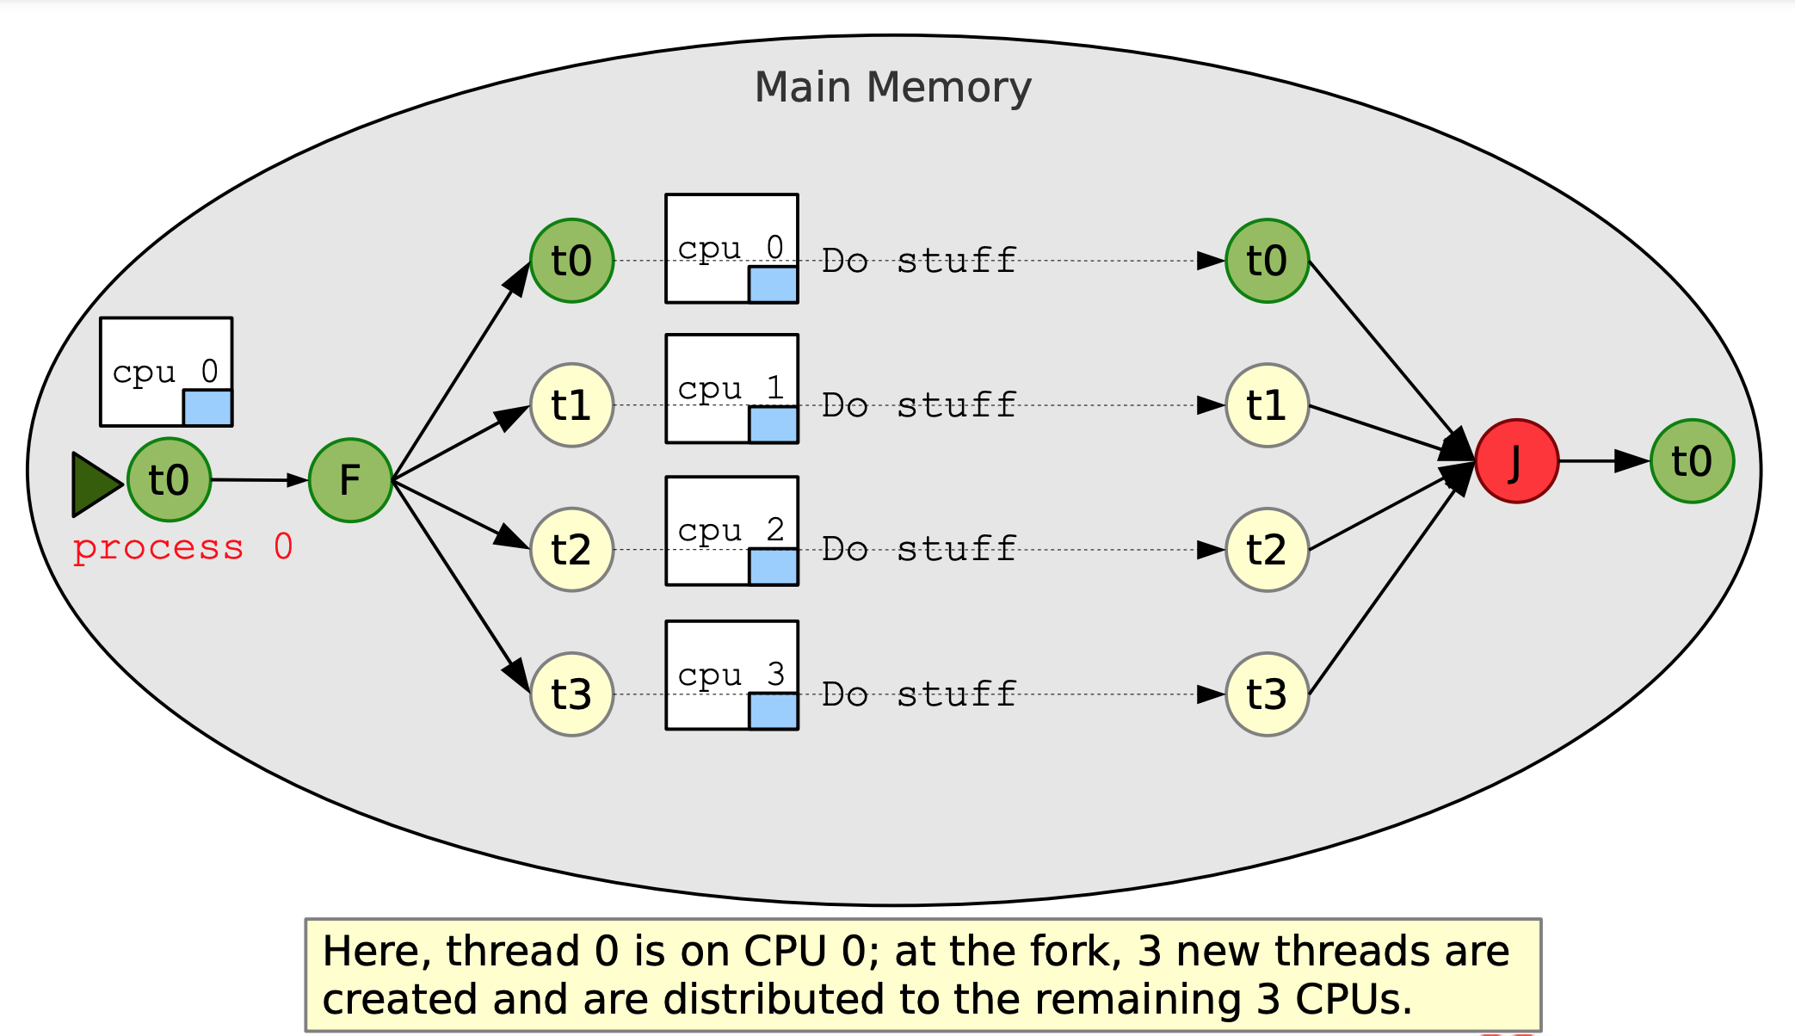
OpenMP Execution Model
Recap!

Slide 14
Variables
Recap!
Variables can shared among threads
Or can be private to a thread
Variable initializations can be specified

Slide 15
Worksharing
Parallelizing loops across threads
Recap!
#include <stdio.h>
#include <omp.h>
int main() {
int matrix[10][15];
int i, j;
// Initialize matrix
for (i = 0; i < 10; ++i) {
for (j = 0; j < 15; ++j) {
matrix[i][j] = i * M + j;
}
}
// Parallel region with shared clause
#pragma omp parallel shared(matrix) private(i, j)
{
#pragma omp for
for (i = 0; i < 10; ++i) {
printf("Thread %d handles row %d\n", omp_get_thread_num(), i);
for (j = 0; j <15; ++j) {
matrix[i][j] *= 2; // Modify matrix element
}
}
}
return 0;
}

Slide 16
Atomicity
Recap!
#include <stdio.h>
#include <omp.h>
int main() {
int sum = 0;
int i;
// Parallel loop where each thread updates sum atomically
#pragma omp parallel for shared(sum) private(i)
for (i = 0; i < 1000; ++i) {
#pragma omp atomic
sum += i;
}
printf("Sum: %d\n", sum);
return 0;
}
Memory can be set aside and updated safely, using, #pragma omp atomic
#pragma omp critical is also an option

Slide 17
Asynchronous Tasking
New!
#include <stdio.h>
#include <omp.h>
int main() {
#pragma omp parallel
{
#pragma omp single // Only 1 thread is running
{
#pragma omp task // Task #1
{
printf("Perl ");
}
#pragma omp task // Task #2
{
printf("rocks! ");
}
} // <~ other threads begin executing
tasks at the end of the 'single'
block
}
return 0;
}
$ gcc -fopenmp ./basic-task.c
$ OMP_NUM_THREADS=4 ./a.out
Perl rocks!
$ OMP_NUM_THREADS=4 ./a.out
rocks! Perl
$
Tasking was introduced in 2008 in OpenMP 3.0 (GCC 4.4)
Generated tasks are atomically assigned to an available (real) CPU thread
2 different execution orderings are possible (see output)

Slide 18
Asynchronous Tasking
Any thread can generate a task
#pragma omp single when starting out so that you can think about your code more easily
All threads in the parallel region are available to pick up a task
#pragma omp taskwait is a synchronization barrier – when no more new tasks are available, all threads wait until all theads are idle to proceed

Slide 19
Asynchronous Tasking
private (list)
firstprivate (list)
default (shared | none)
if ([task:] scalar-logical-expression)
final (scalar-logical-expression)
mergeable
depend (dependency-type: list)
priority (priority-value)
untied
Affected by:
OMP_MAX_TASK_PRIORITY (supported by OpenMP::Environment)

Slide 20
Asynchronous Tasking
Synchronizing Tasks
#include <stdio.h>
#include <omp.h>
int main() {
#pragma omp parallel
{
#pragma omp single // Only 1 thread is running
{
#pragma omp task // Task #1
{
printf("Perl ");
}
#pragma omp taskwait
#pragma omp task // Task #2
{
printf("rocks! ");
}
}
}
return 0;
}:w
$ gcc -fopenmp ./basic-task.c
$ OMP_NUM_THREADS=4 ./a.out
Perl rocks!
$ OMP_NUM_THREADS=4 ./a.out
Perl rocks!
$ OMP_NUM_THREADS=4 ./a.out
Perl rocks!
Tasking was introduced in 2008 in OpenMP 3.0 (GCC 4.4)
Generated tasks are atomically assigned to an available (real) CPU thread
2 different execution orderings are possible (see output)

Slide 21
OpenMP Tasking + Perl
use strict;
use warnings;
use OpenMP::Simple;
use OpenMP::Environment;
use Inline (
C => 'DATA',
with => qw/OpenMP::Simple/,
);
my $env = OpenMP::Environment->new;
for my $num_threads ( 1 .. 16 ) {
my $current_value = $env->omp_num_threads($num_threads);
my $got_threads = run_tasks();
}
__DATA__
__C__
int run_tasks() {
int got_num_threads = 0;
PerlOMP_UPDATE_WITH_ENV__NUM_THREADS
#pragma omp parallel
{
got_num_threads = omp_get_num_threads();
#pragma omp single // Ensure only one thread creates the initial task
{
#pragma omp task
{printf("Perl ");} // Task #1
#pragma omp task
{printf("rocks ");} // Task #2
#pragma omp task
{printf("on %d threads!\n", got_num_threads);} // Task #3
#pragma omp taskwait
}
}
return got_num_threads;
}
on 1 threads!
rocks Perl on 2 threads!
rocks Perl Perl rocks on 3 threads!
Perl rocks on 4 threads!
Perl rocks on 5 threads!
Perl rocks on 6 threads!
Perl rocks on 7 threads!
Perl rocks on 8 threads!
Perl rocks on 9 threads!
Perl rocks on 10 threads!
Perl rocks on 11 threads!
Perl rocks on 12 threads!
Perl rocks on 13 threads!
Perl rocks on 14 threads!
Perl rocks on 15 threads!
Perl rocks on 16 threads!

Slide 22
Thread Affinity
New!
Setting thread affinity (OMP_PROC_BIND) helps optimize performance by improving cache and memory access patterns on NUMA architectures.
OMP_PROC_BIND has 4 possible values:
  true or close (as in near)
  master
  spread
  false (or unset)

Slide 23
Thread Affinity
OMP_PROC_BIND=true or OMP_PROC_BIND=close:
  Threads are bound close to where the master thread is running. It is useful for ensuring threads operate near each other to minimize cross-socket memory access.
OMP_PROC_BIND=spread:
  Threads are spread out across the available sockets (NUMA nodes). This setting aims to balance the workload across all available CPU sockets.
OMP_PROC_BIND=master:
  Threads are bound to the same CPU core as the master thread. This can be useful in scenarios where thread locality with respect to the master thread is critical.
OMP_PROC_BIND=false or unset:
  OpenMP runtime system decides the thread binding strategy based on the system default or runtime decisions. This may vary between different OpenMP implementations and system configurations.

Slide 24
Thread Affinity
use strict;
use warnings;
use OpenMP::Simple;
use OpenMP::Environment;
use Inline (
C => 'DATA',
with => qw/OpenMP::Simple/,
);
my $env = OpenMP::Environment->new;
foreach my $policy (qw/true close spread master false/) {
for my $num_threads ( 1 .. 16 ) {
my $current_value = $env->omp_num_threads($num_threads);
my $current_policy = $env->omp_proc_bind($policy);
my $got_threads = runit();
}
}
__DATA__
__C__
int runit() {
PerlOMP_UPDATE_WITH_ENV__NUM_THREADS
// Start a parallel region
#pragma omp parallel
{
int thread_id = omp_get_thread_num();
printf("Thread %d is running on CPU %d\n", thread_id, sched_getcpu());
}
return 0;
}
__END__
OpenMP runtime

Slide 25
SIMD
Single Instruction Multiple Data
New!
SIMD and Performance: SIMD OpenMP directives are essential for achieving high performance on modern processors by exploiting parallelism at the instruction level. Proper usage of SIMD can significantly accelerate computational tasks that operate on large arrays or matrices.
Limitations: Not all loops can be effectively vectorized using SIMD directives. Loop-carried dependencies, complex control flow, or irregular memory access patterns may hinder vectorization.
Evolution: OpenMP continues to evolve with newer versions (5.0 and beyond), introducing enhancements and new features for SIMD support, such as SIMD-awareness in array sections (simd clause with aligned, linear, etc.).
The simd construct has been introduced, but no new environmental variables or runtime functions have been introduced to support it.

Slide 26
SIMD Example
#include <stdio.h>
#include <omp.h>
int main() {
int matrix[100][50];
int result[100][50];
int i, j, k; // Declare loop indices outside of the loops
// Initialize matrix
for (i = 0; i < 100; ++i) {
for (j = 0; j < 50; ++j) {
matrix[i][j] = i * 50 + j;
}
}
// Parallel region with nested loop vectorization
#pragma omp parallel for collapse(2) private(i, j, k)
for (i = 0; i < 100; ++i) {
for (j = 0; j < 50; ++j) {
#pragma omp simd
for (k = 0; k < 4; ++k) { // Assume vector length is 4
result[i][j] += matrix[i][j] * k;
}
}
}
return 0;
}

Slide 27
SIMD Support in CPUs
x86 (Intel and AMD):
  SSE (Streaming SIMD Extensions): Introduced with Pentium III processors, SSE provides SIMD support for operations on floating-point and integer data types. SSE has evolved through multiple versions (SSE2, SSE3, SSE4) with increased capabilities for parallel processing.
  AVX (Advanced Vector Extensions): AVX builds upon SSE and offers wider SIMD registers (256-bit and 512-bit), enabling higher throughput for vectorized operations. AVX2 and AVX-512 further enhance vectorization performance.
ARM (Various Manufacturers):
  NEON: NEON is ARM's SIMD architecture extension, providing similar functionality to SSE on x86 processors. It supports vector operations on integers and floating-point data types, enhancing performance for multimedia and signal processing applications.
Compiler vendors such as GCC, Intel ICC, Clang, and others implement SIMD support for various architectures. They provide tools and flags (-fopenmp, -mavx, -mfpu=neon, etc.) to enable and control SIMD vectorization, ensuring compatibility with OpenMP directives for parallel programming.

Slide 28
Heterogeneous Architectures
(e.g., GPUs)
New!
#include <stdio.h>
#include <omp.h>
int main() {
int a = 10, b = 20, c;
#pragma omp target map(from:c)
{
c = a + b;
}
printf("Result: %d\n", c);
return 0;
}

Slide 29
Compiling for GPUs
Requires use of target OpenMP directive
Requires compiler support that link to external libraries (e.g., CUDA, etc)
Enabled in gcc via -fopenmp

Slide 30
GCC Offloading & nvptx-none
Offloading Support:
GCC introduced support for offloading computations to accelerators such as GPUs starting from version 4.9. This allows parallel sections of code annotated with OpenMP directives (target, parallel, etc.) to be executed on devices like NVIDIA GPUs.
Target Architecture:
-foffload=nvptx-none specifies that the offloaded code should target NVIDIA GPUs using the NVIDIA Parallel Thread Execution (PTX) intermediate representation (nvptx). PTX is a portable assembly-like language that NVIDIA GPUs can execute.
Compilation Process:
When you compile a program with -foffload=nvptx-none, GCC generates PTX code (nvptx) instead of native GPU machine code. PTX is architecture-independent and serves as an intermediate representation.
The generated PTX code can then be further compiled and optimized by NVIDIA's CUDA toolchain (nvptx-as, nvptx-nvcc) into executable machine code (cubin) that runs on NVIDIA GPUs.

Slide 31
GCC Offloading & nvptx-none
Command Usage:
Example command to compile a program (program.c) with OpenMP offloading to NVIDIA GPUs:
gcc -o program -fopenmp -foffload=nvptx-none program.c
-fopenmp: Enables OpenMP support in GCC.
-foffload=nvptx-none: Specifies that the offloaded code should target NVIDIA GPUs using PTX.
CUDA Toolkit Requirement:
To execute programs compiled with -foffload=nvptx-none, you need to have the NVIDIA CUDA toolkit installed on your system. The CUDA toolkit provides necessary libraries and tools (nvptx-as, nvptx-nvcc) to compile PTX code into executable GPU machine code.
Hardware and Driver Support:
Ensure that your system has compatible NVIDIA GPU hardware ad drivers installed. The CUDA toolkit supports a wide range of NVIDIA GPUs, and performance can vary based on GPU architecture and capabilities.

Slide 32
More OpenMP, GPUs, Offloading
https://gcc.gnu.org/projects/gomp/
https://gcc.gnu.org/wiki/Offloading
Many online tutorials and examples
Books exist, such as:

Slide 33
Present & Future Direction
All Perl modules presented here are geared towards running and controlling Inline::C with OpenMP
Current work is easy getting Perl variables into and out of Inline::C'd functions
Near future: more options from OpenMP::Simple for OpenMP first programmers (variable IN,OUT; internal transforms)
Ultimate goal: provide thread-safe (OpenMP) RW of variables directly via Perl API (or similar type of library via OpenMP::Simple)

Slide 34
Perl+OpenMP for Fortran?
Very possible with gfortran and highly desirable, but ..
I'd need a suitable Inline module for Fortran 90
I am open to doing this pro bono if we had a working Inline::Fortran module

Slide 35
OpenACC
a programming standard for parallel computing developed by Cray, CAPS, Nvidia and PGI
Same directives/runtime based approach as OpenMP
Also supported by GCC (9.1 offers “nearly complete OpenACC spec 2.5 support)
Perl+OpenMP project has no intention to support it
But the opportunity is there
I am open to being sponsored for the work

Slide 36

Perl+OpenMP
Where it happens!
https://github.com/Perl-OpenMP
May become part of Perl Community's HPC Perl Committee (details still being worked out)
https://github.com/Perl-OpenMP

Slide 37





Thank You

